Slide 1
Microsoft Connect();

Slide 2

The video for this presentation can be found here

Slide 3

Build and ship awesome apps with C# and Visual Studio App Center
Nat Friedman
CVP Developer Platform & Tools
Microsoft

Slide 4

Microsoft ♥ Developer Productivity

Slide 5

Software drives more of the things we do every day.

Slide 6
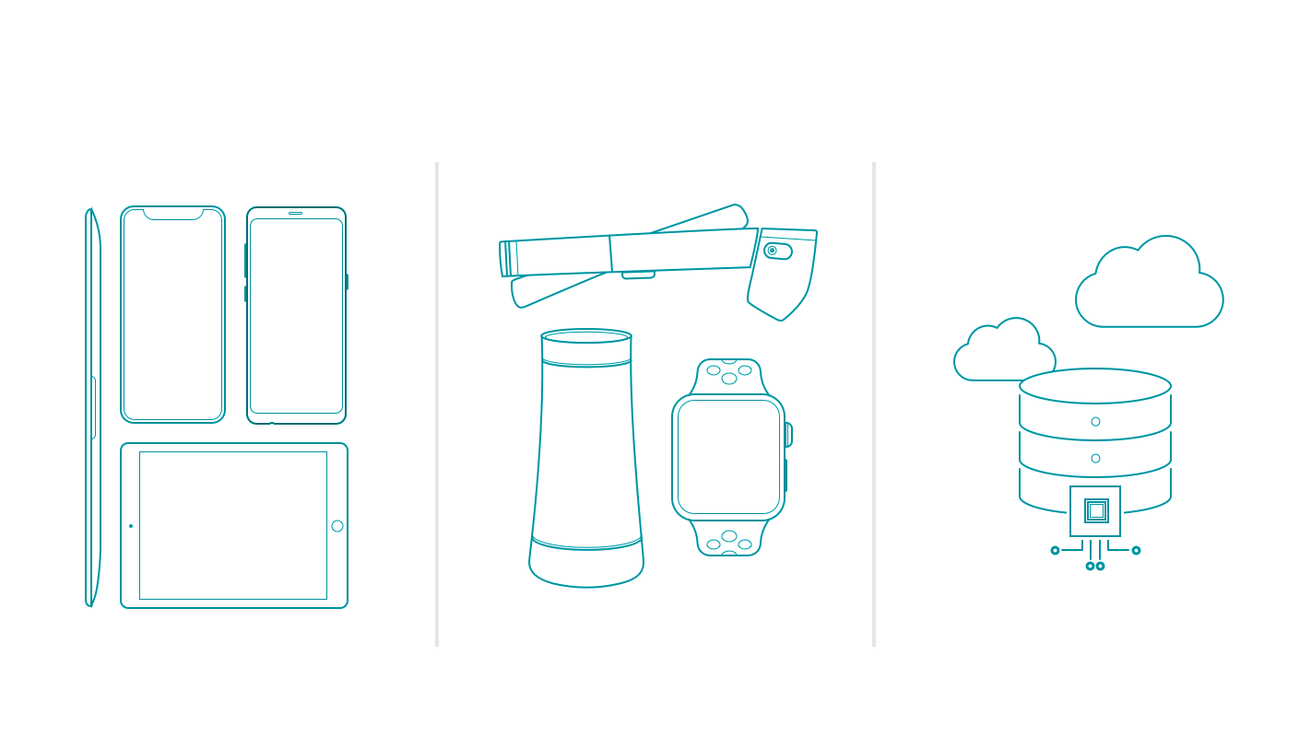
New challenges
More devices
Emerging platforms
Data & intelligence

Slide 7

Skip inessential steps
Before
After
Repetitive & Inessential Steps
Essential Work Only

Slide 8
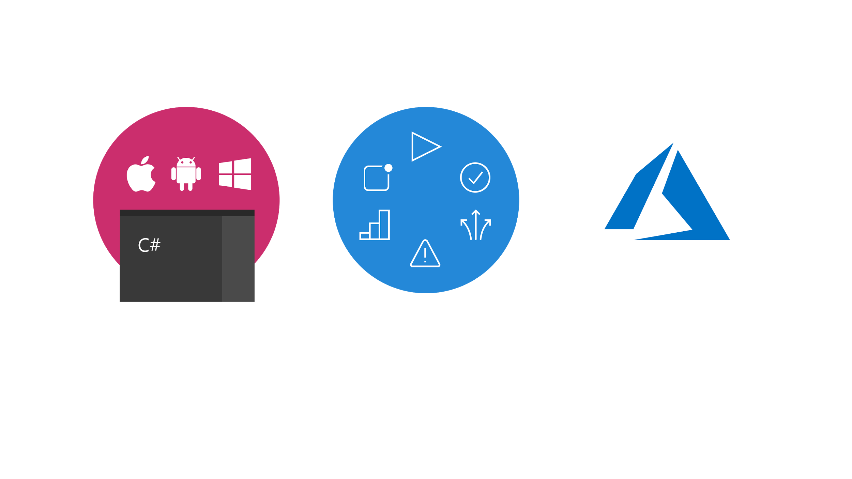
Powerful Platform
Automated DevOps
Intelligent Cloud

Slide 9
Powerful Platform
Automated DevOps
Intelligent Cloud

Slide 10



Powerful Platform
Write less code with C# and Visual Studio
James
Montemagno

Slide 11
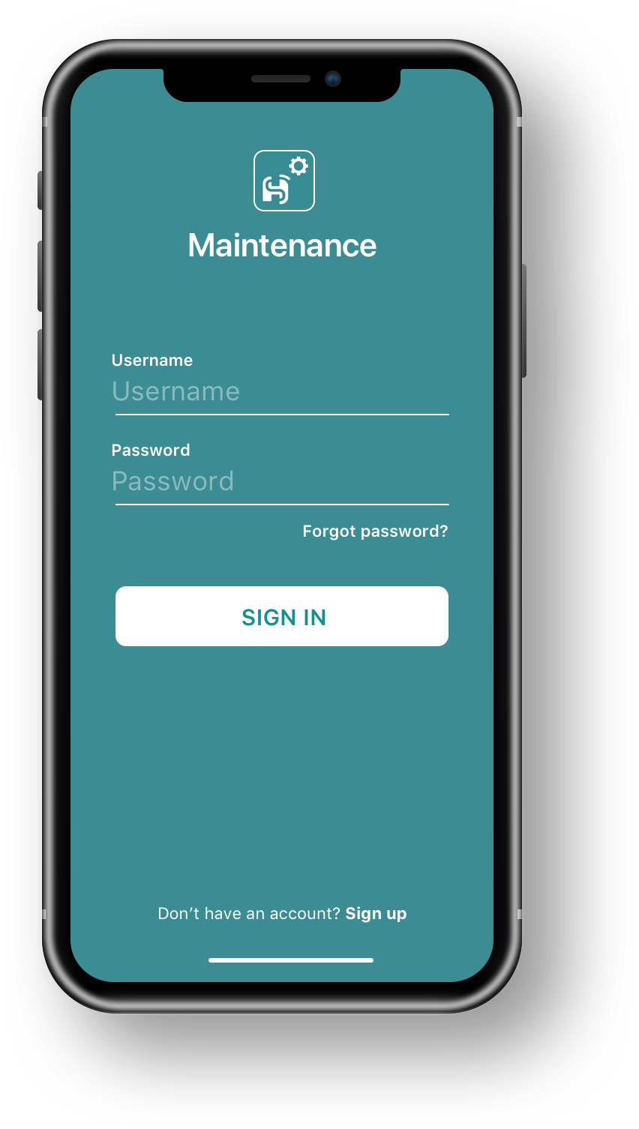
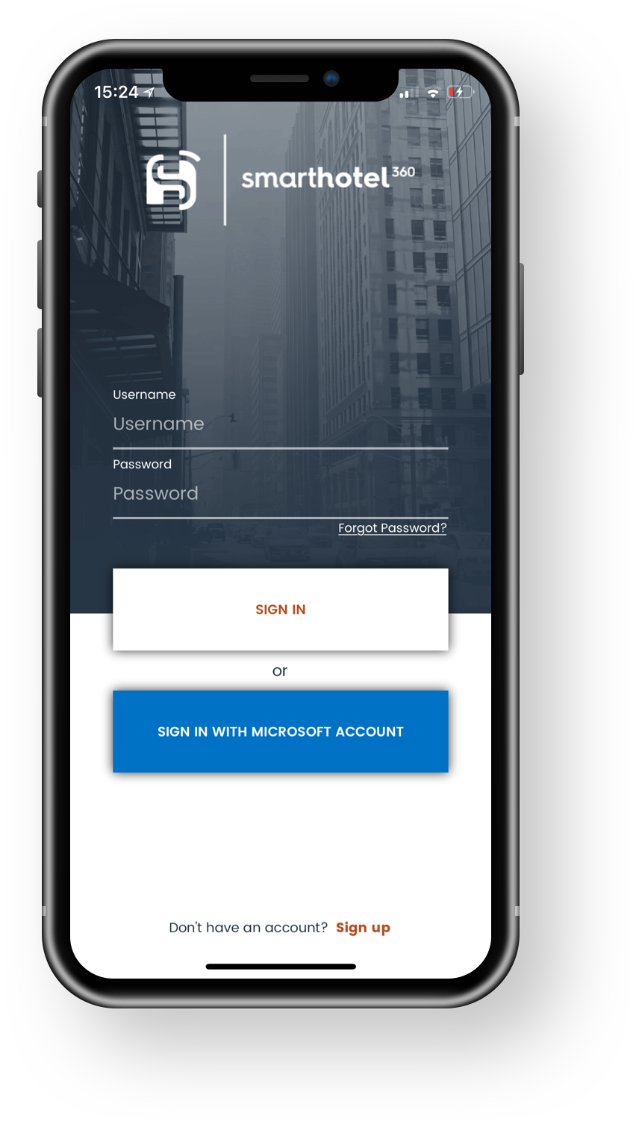


Hotel Staff
iOS
Hotel Guest
iOS

Slide 12
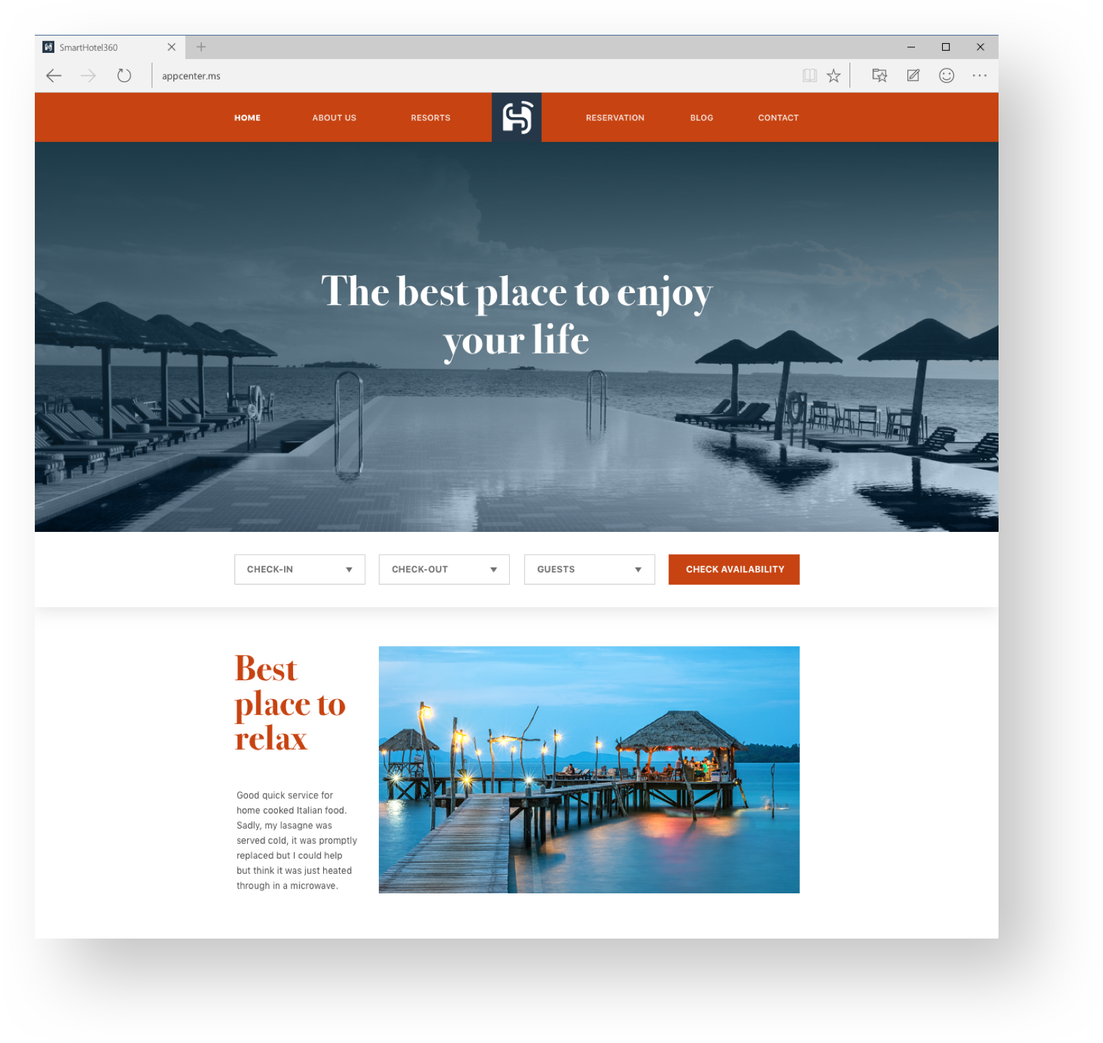
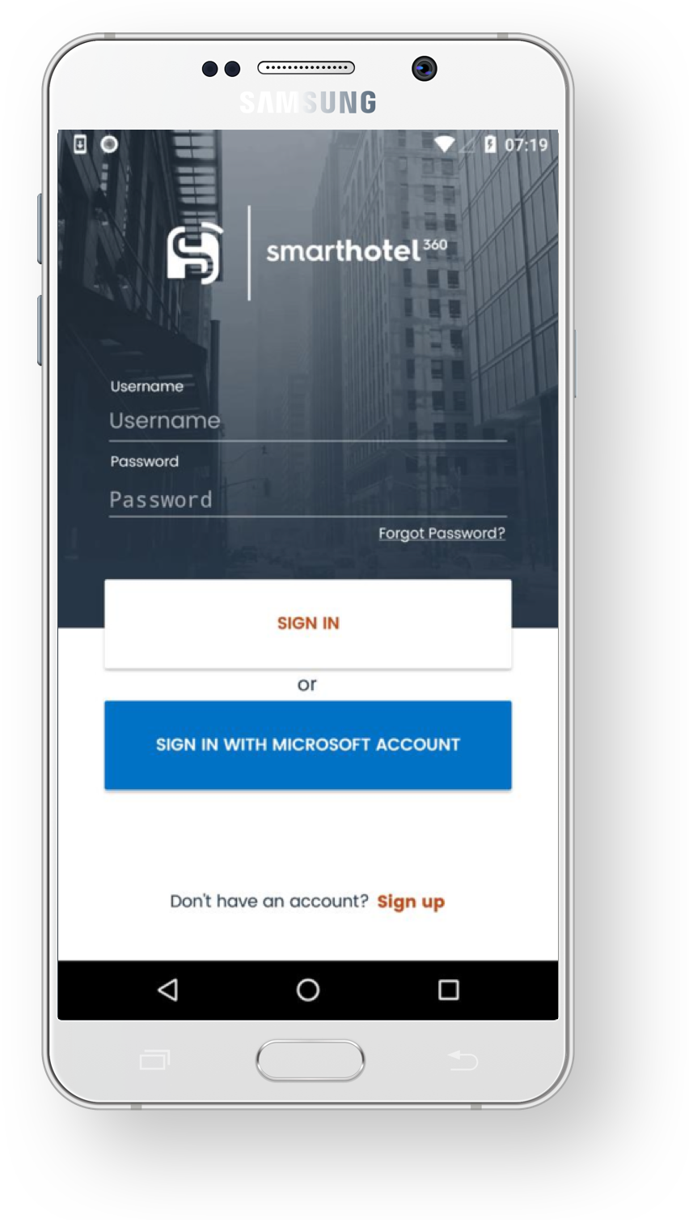
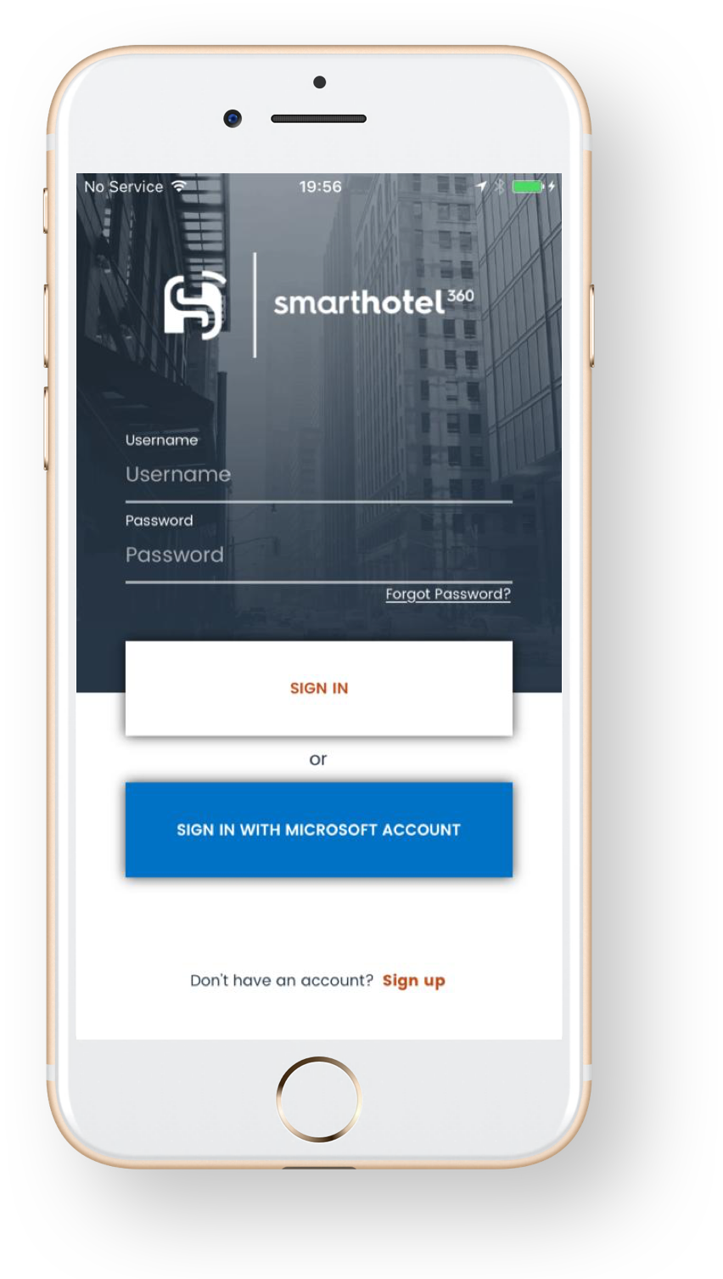
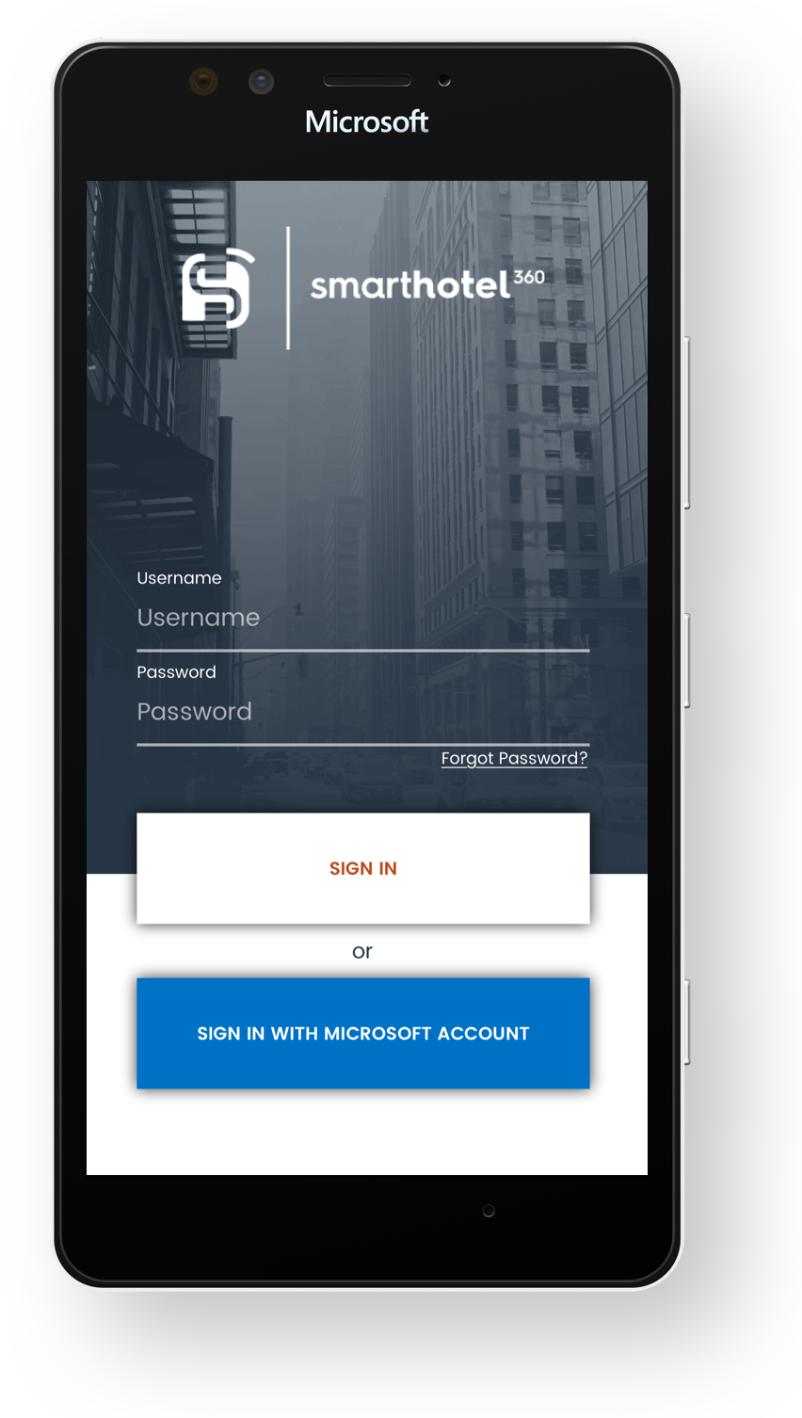
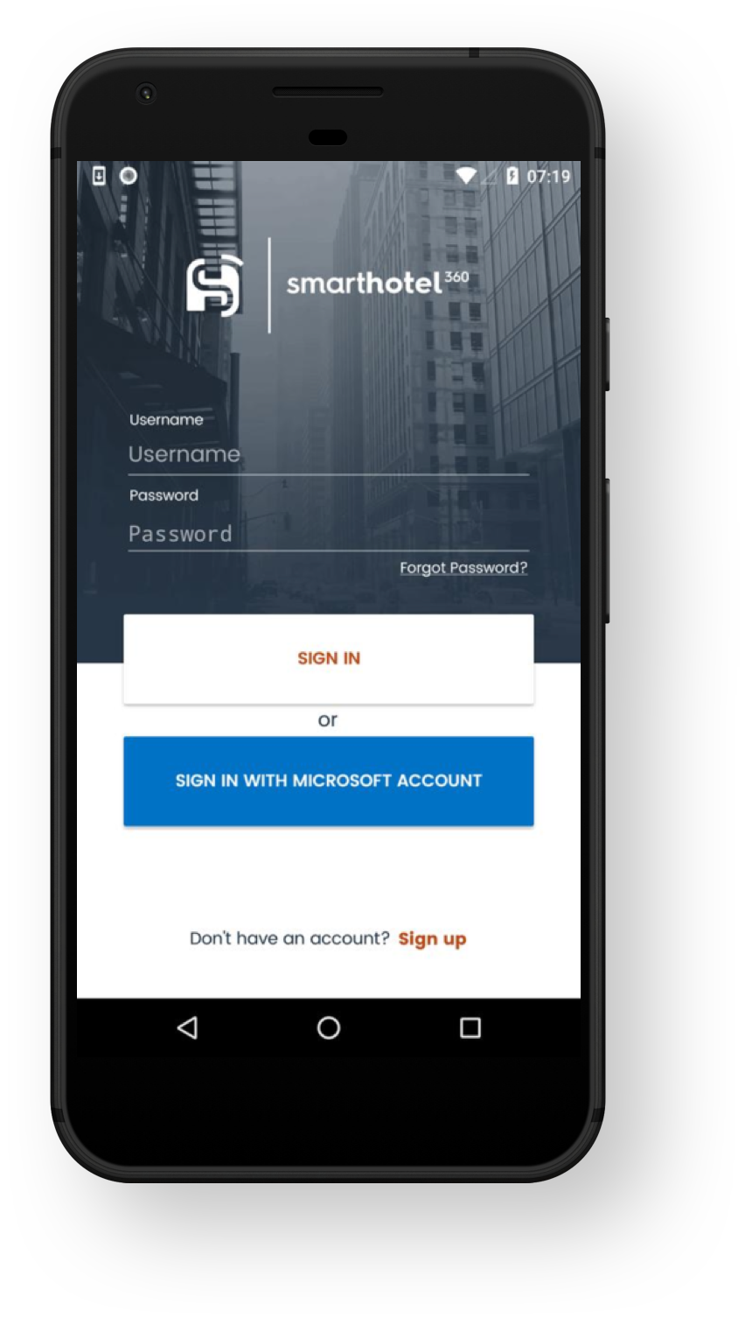
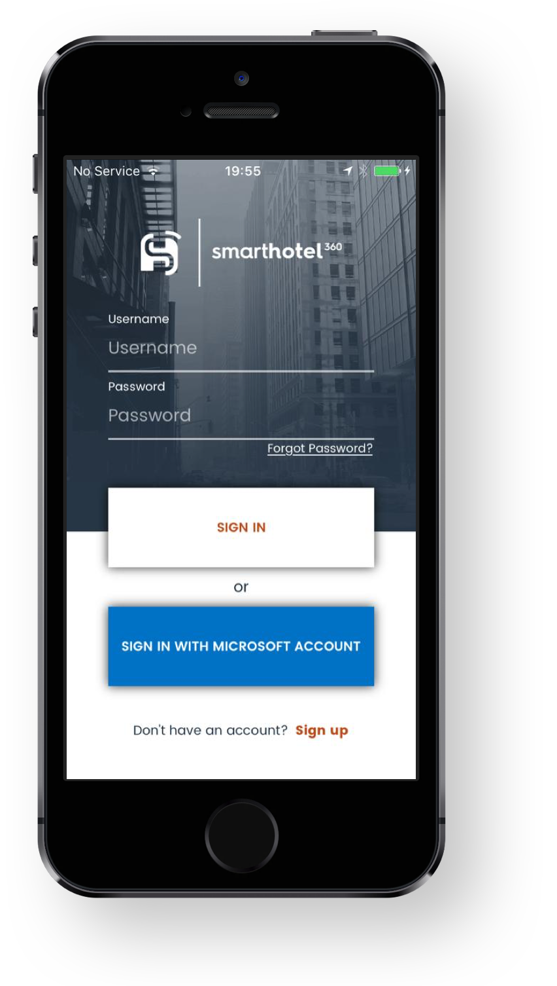

Hotel Staff
Android
Hotel Staff
iOS
Hotel Guest
Android
Hotel Guest
iOS
Hotel Guest
Web

Slide 13
XAML Standard
Xamarin.Forms updates, aligned to UWP
New Types
TextBox, Border, ComboBox, ProgressRing, StackPanel, TextBlock, ToggleSwitch, UserControl
New Properties
Foreground, Background, BorderBrush, BorderThickness, Value, FontStyle, FontWeights, Orientation, Stretch, TextWrapping
Preview available: aka.ms/xf-xamlstandard

Slide 14
Powerful Platform
Automated DevOps
Intelligent Cloud

Slide 15

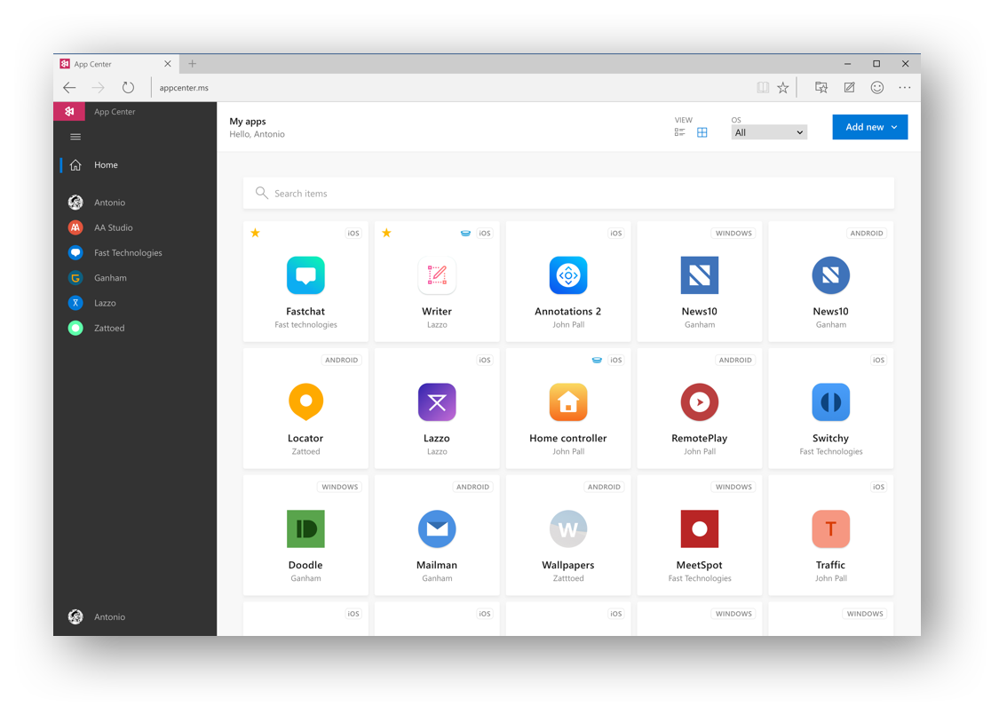
Visual Studio
App Center
appcenter.ms

Slide 16
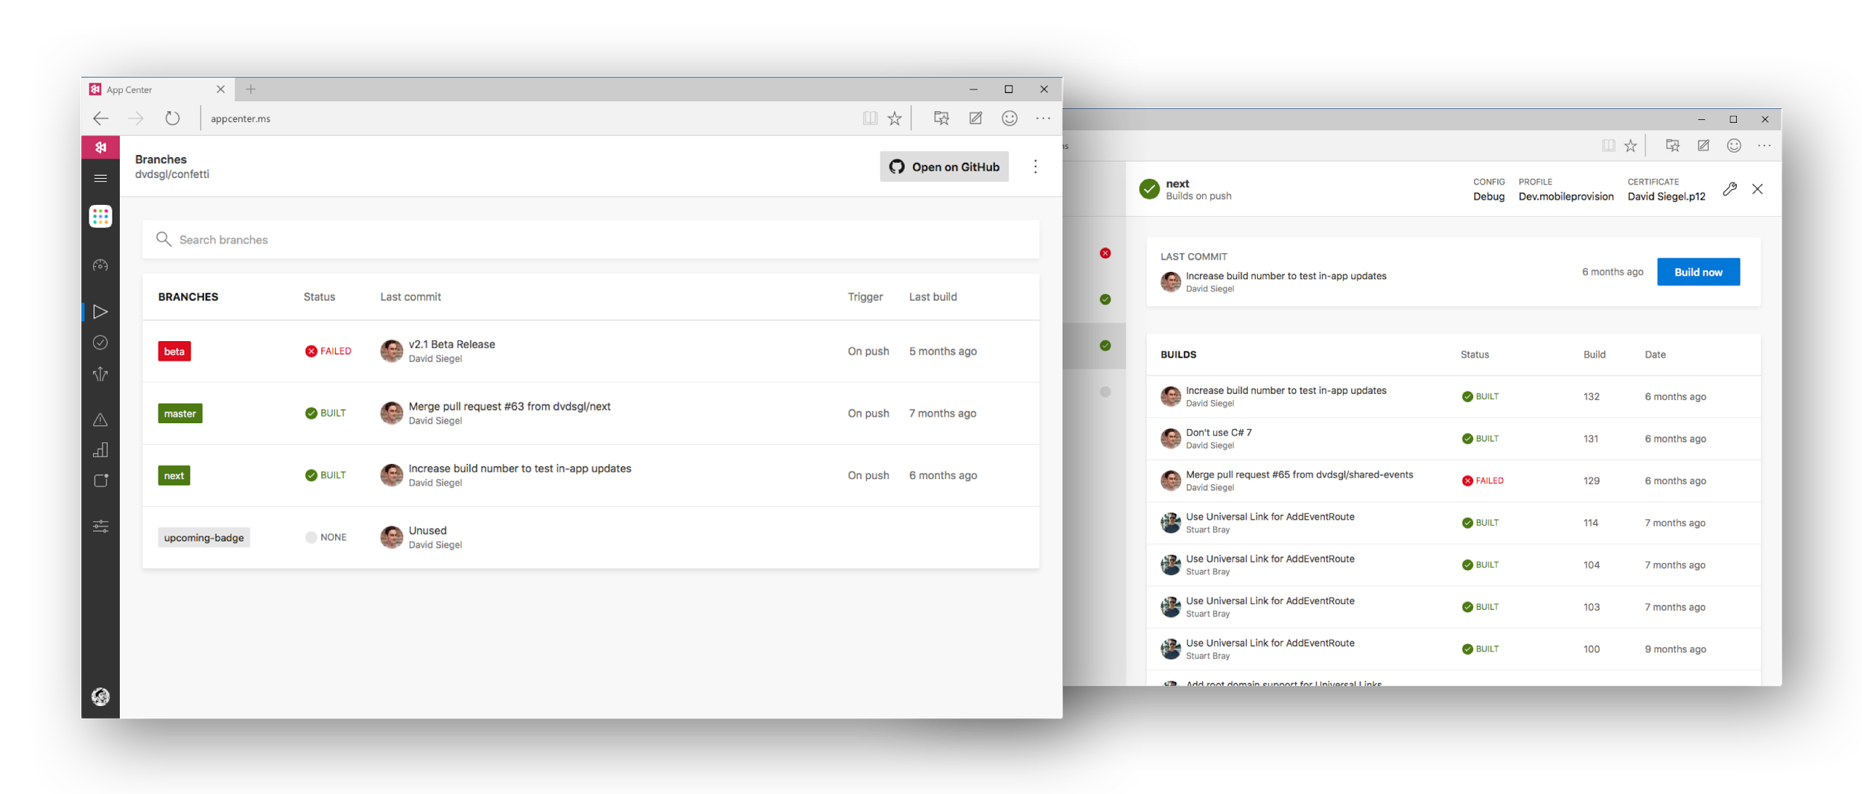






Visual Studio App Center

Slide 17
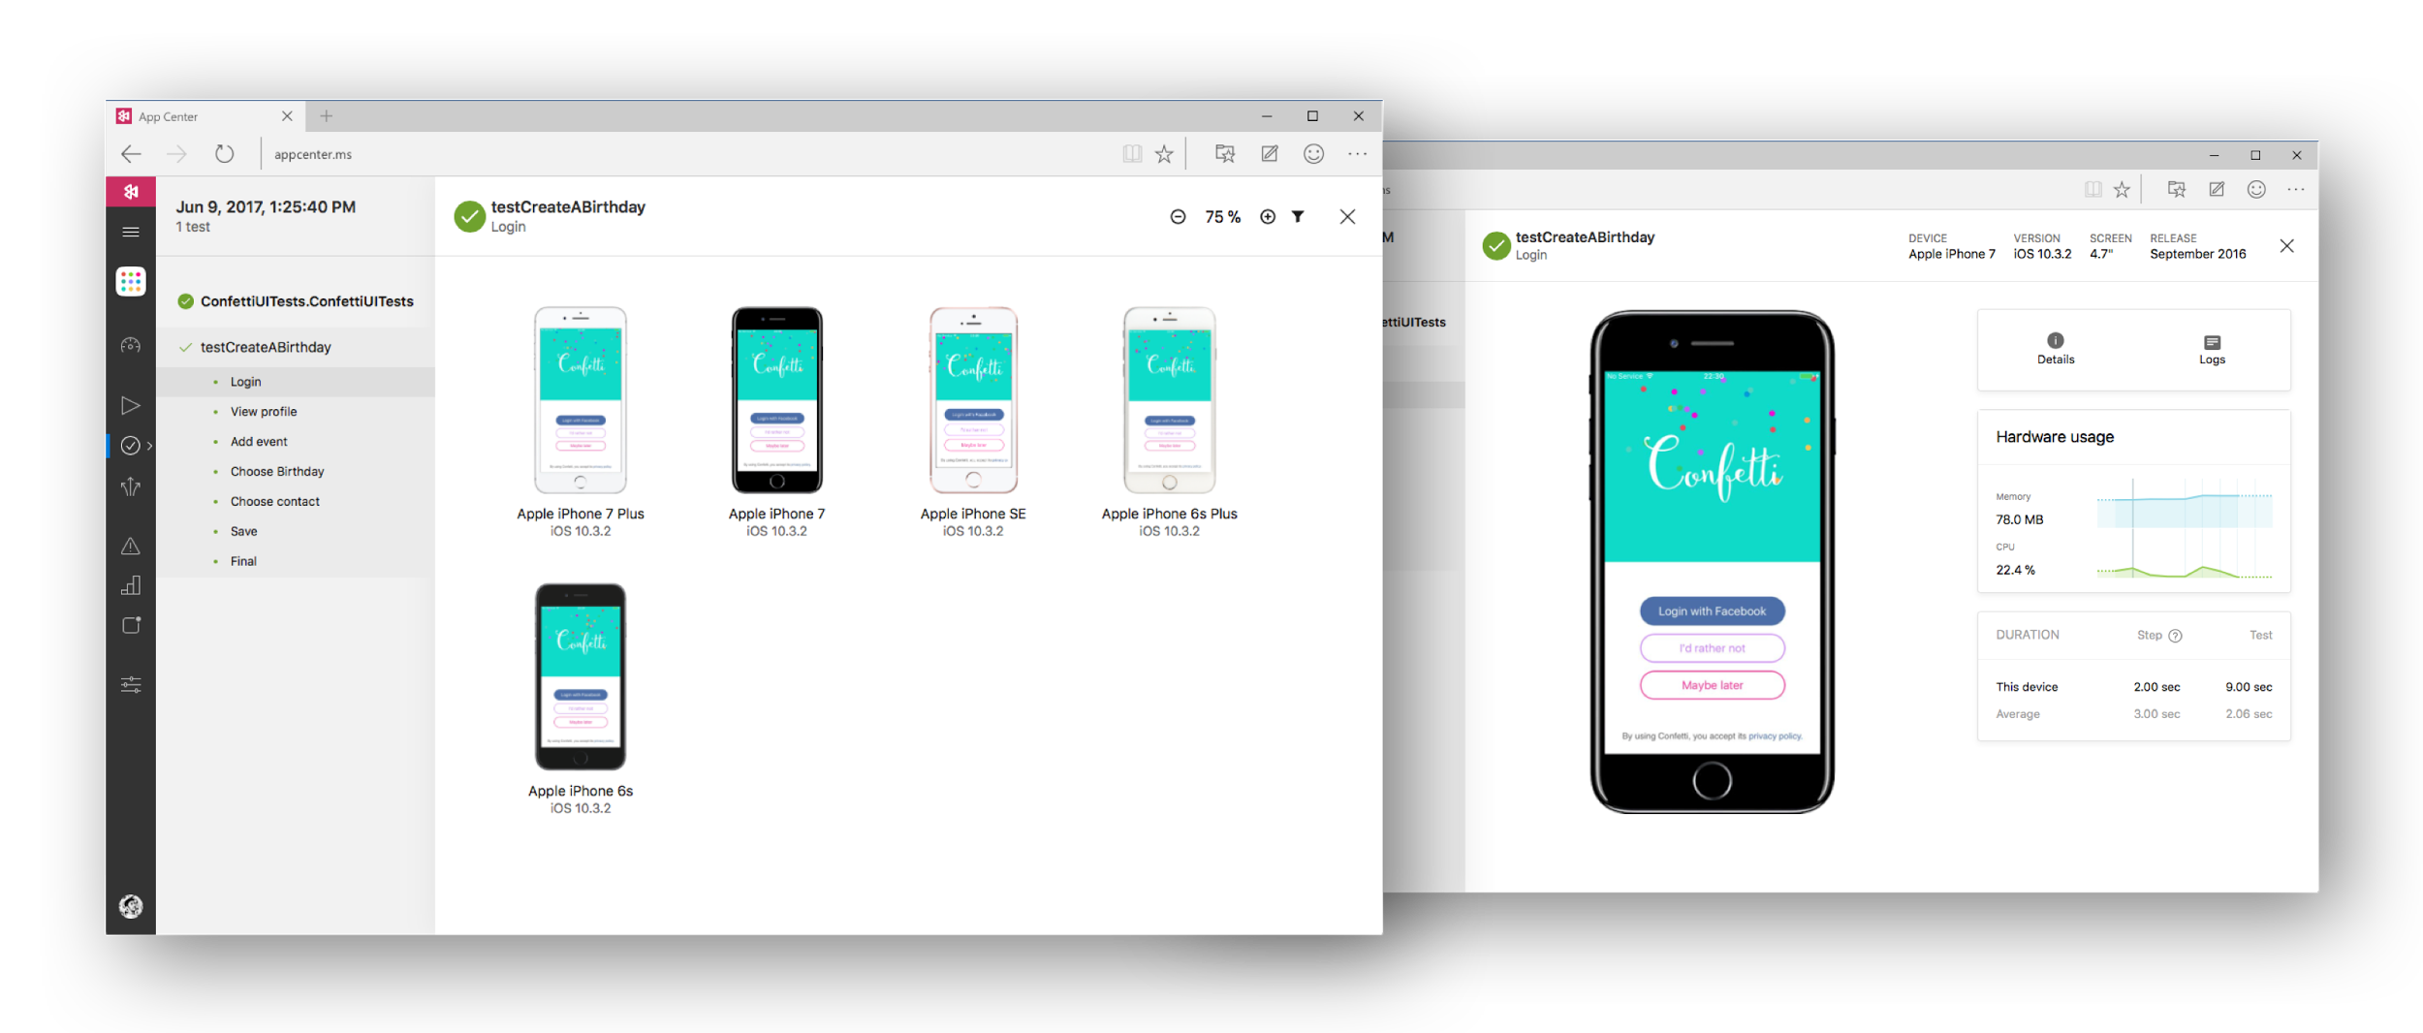


Visual Studio App Center

Slide 18
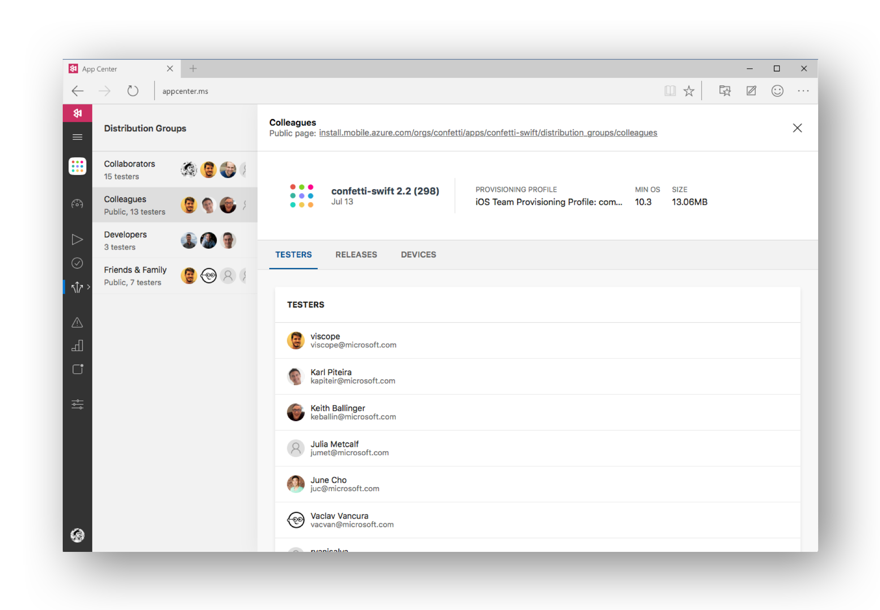

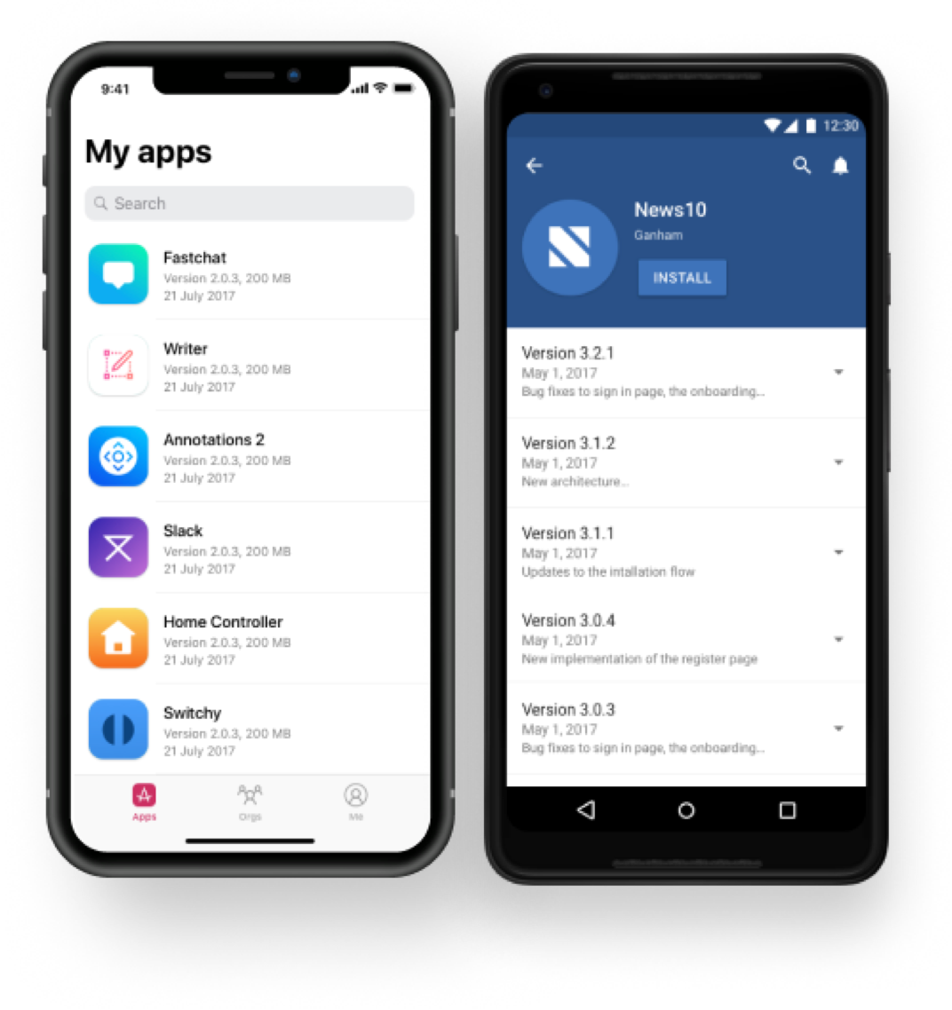

Visual Studio App Center
HockeyApp
iOS, Android, UWP

Slide 19
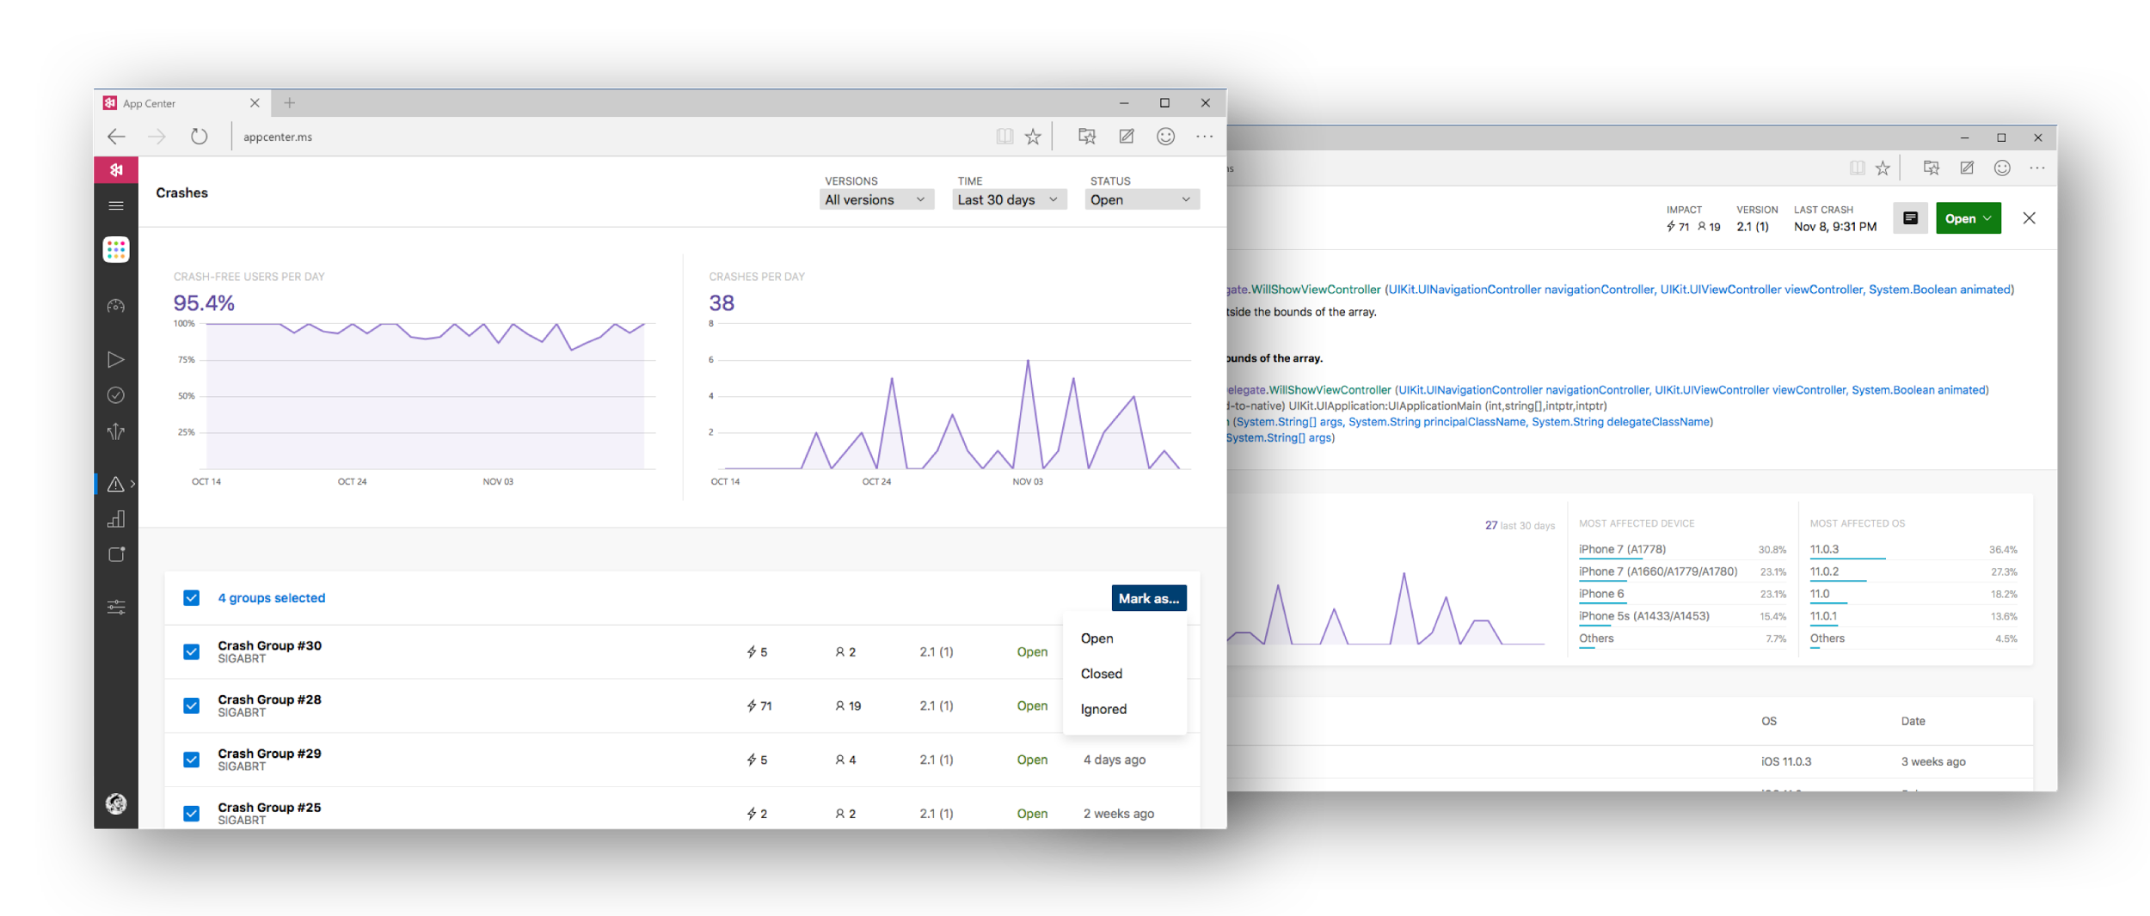

Visual Studio App Center
Notes:
Once it’s in production, App Center collects crash reports to help you diagnose problems and fix bugs faster.

Slide 20
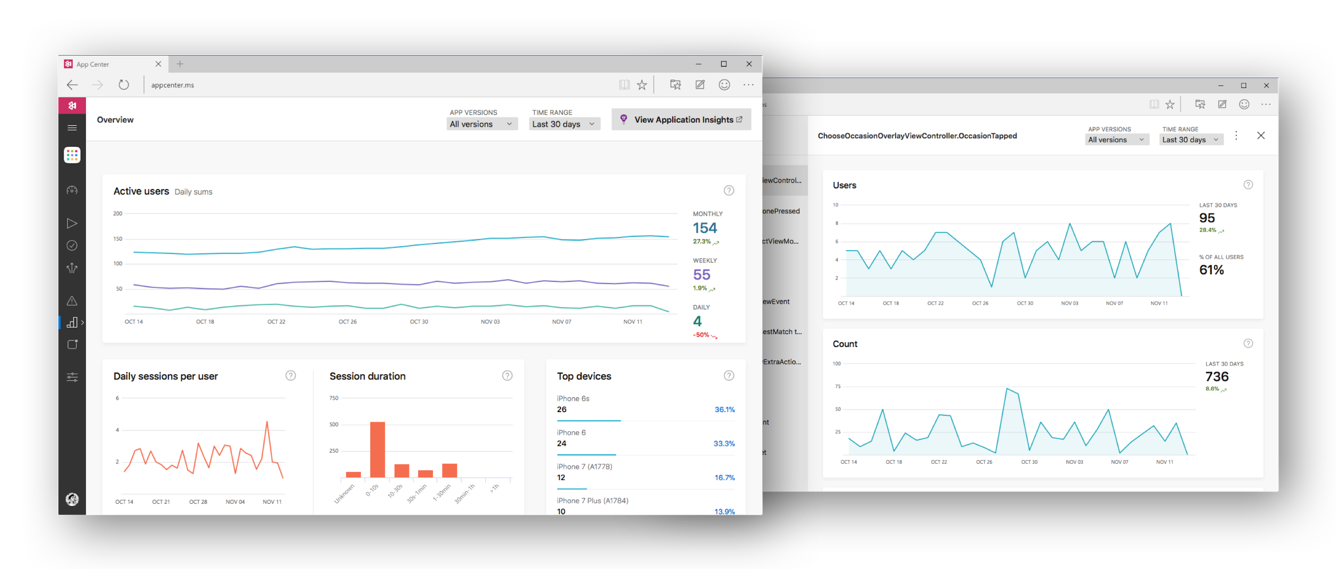

Visual Studio App Center

Slide 21
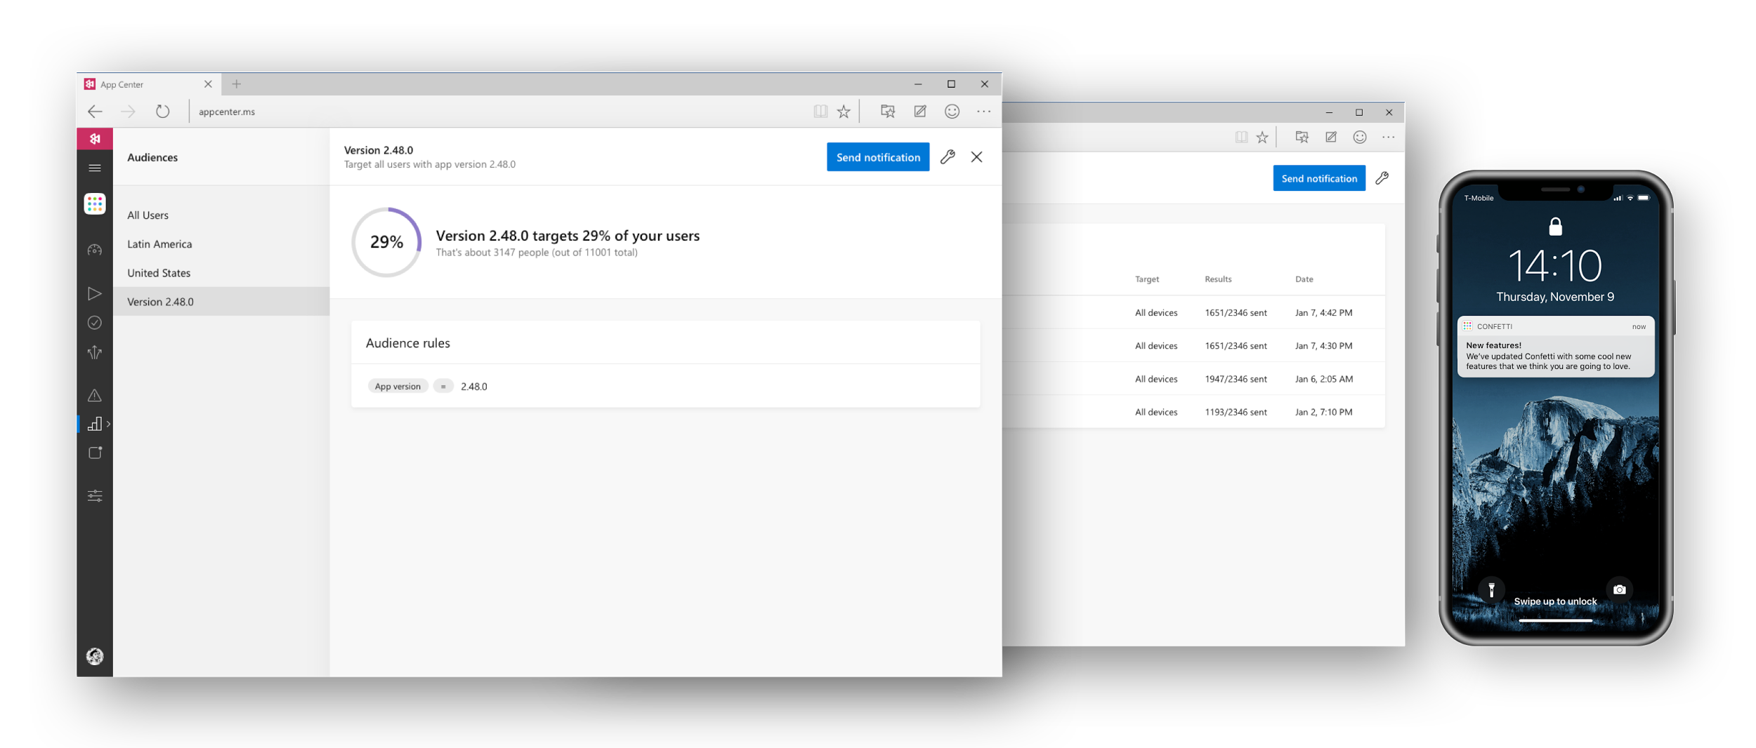

Visual Studio App Center

Slide 22


Efficient DevOps
Automate everything with
Visual Studio App Center
Thomas
Dohmke

Slide 23


Start today for free
Build: 240 minutes per month
Test: 30-day trial
Distribute: All features
Analytics: All features
Crash Reporting: All features
Push Notifications: 5 audiences
Concurrent builds
Concurrent test devices
Push to +100k users
$40/mo
$99/mo
$10/mo

Slide 24












Slide 25

Hugh Vidos
Engineering Manager, Grab
Special
Guest

Slide 26
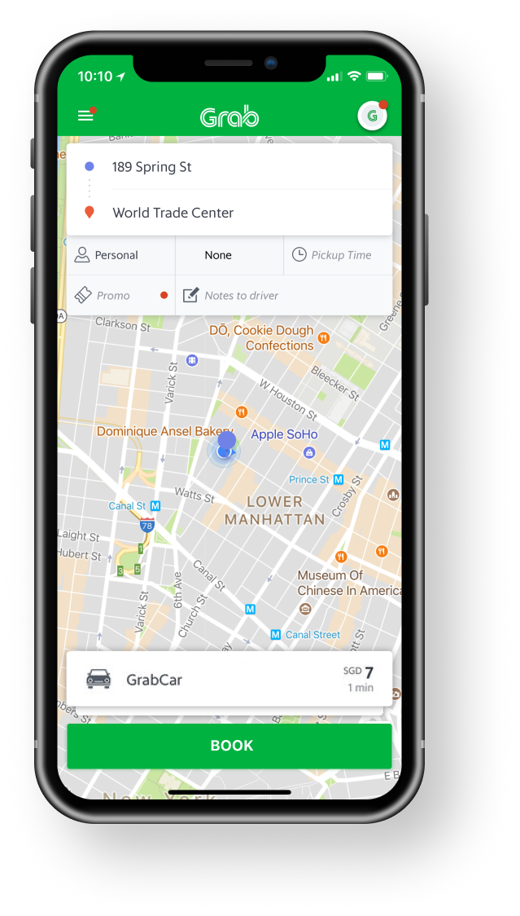
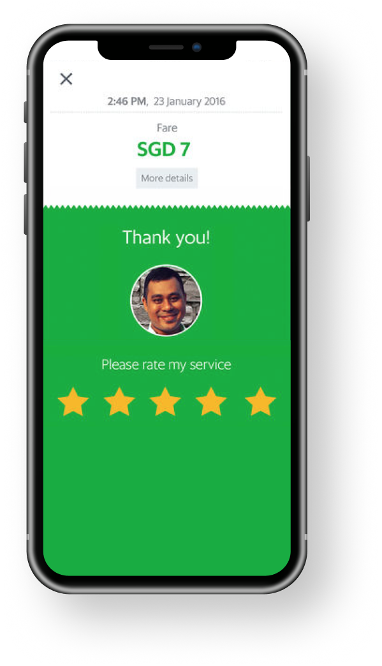

Grab

Slide 27
Powerful Platform
Automated DevOps
Intelligent Cloud

Slide 28


Intelligent Cloud
Power apps with intelligent services to innovate at scale
Dimah
Zaidalkilani

Slide 29
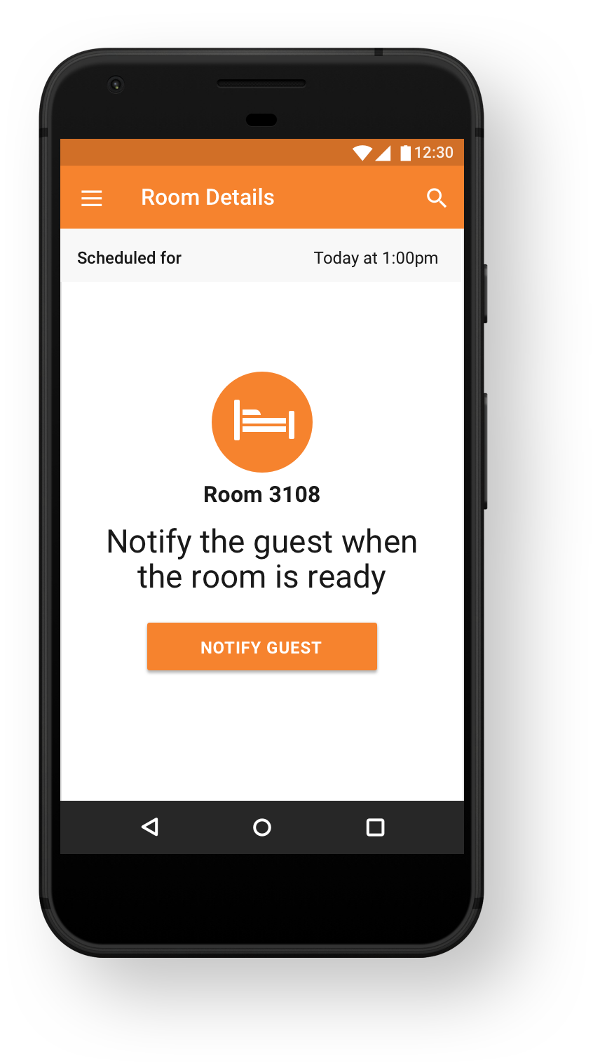
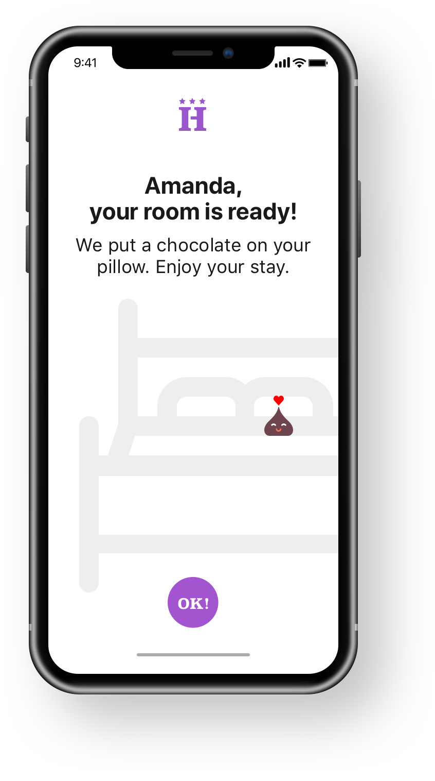

Hotel Staff
Android
Hotel Guest
iOS

Slide 30



Cosmos DB
Azure Functions
App Center
Hotel Staff
Android
Hotel Guest
iOS

Slide 31
Powerful Platform
Automated DevOps
Intelligent Cloud

Slide 32





Visual Studio
Visual Studio for Mac
The Visual Studio
family
Visual Studio Code
Microsoft Azure
Best-in-class tools for any developer
Visual Studio App Center
Visual Studio Team Services

Slide 33
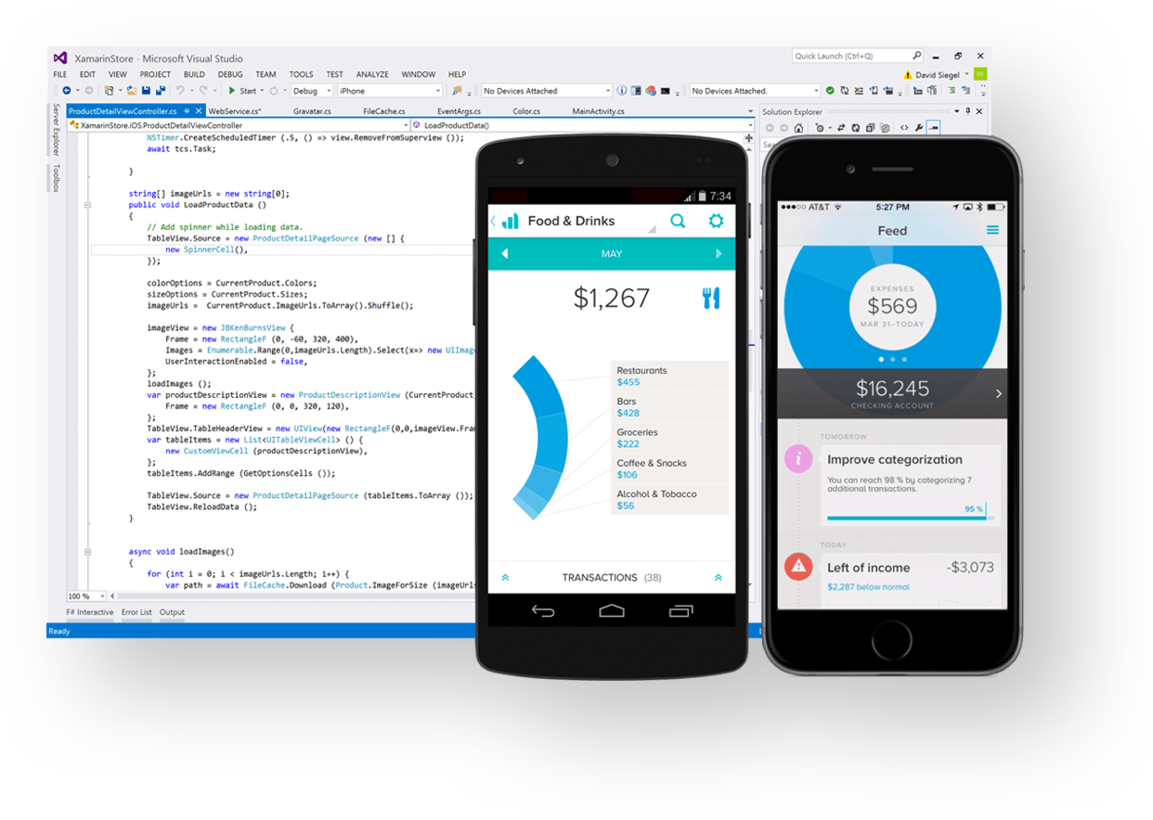
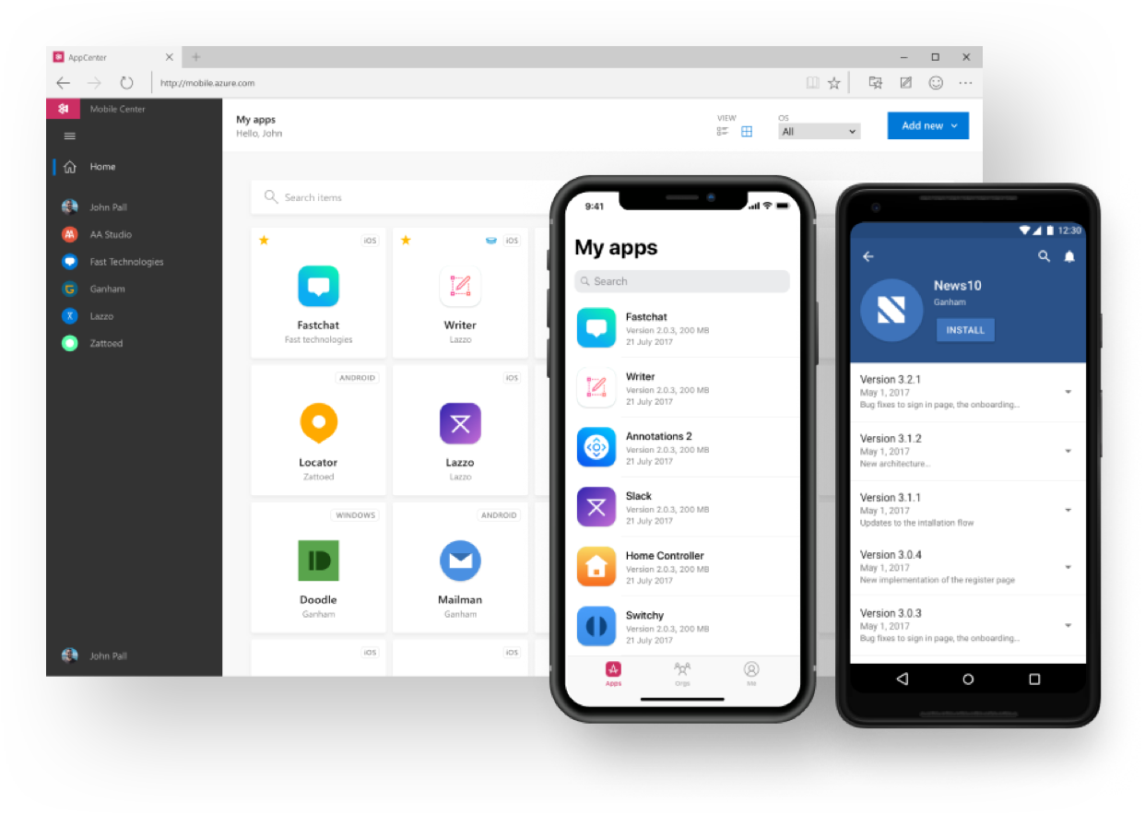
Visual Studio Tools for Xamarin
Visual Studio App Center
visualstudio.com/xamarin
appcenter.ms

Slide 34

© Copyright Microsoft Corporation. All rights reserved.
Notes:
Thanks!

